Slide 1
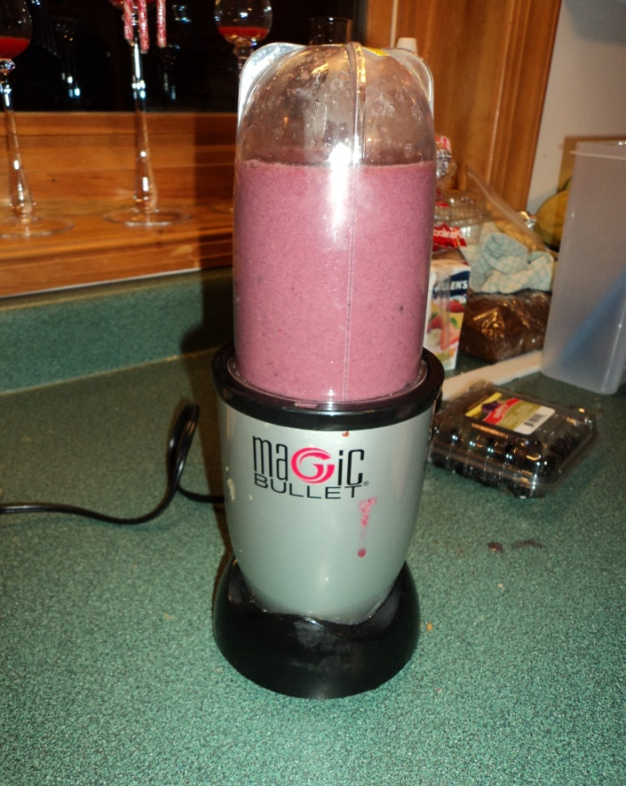
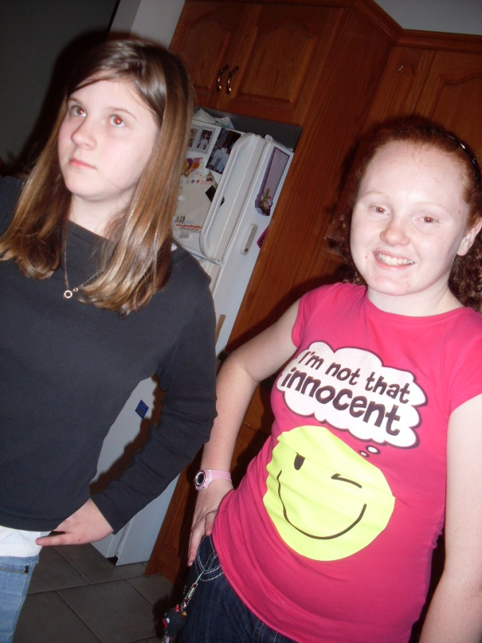

The Magic bullet
BY Daryka M and Ashley J

Slide 2
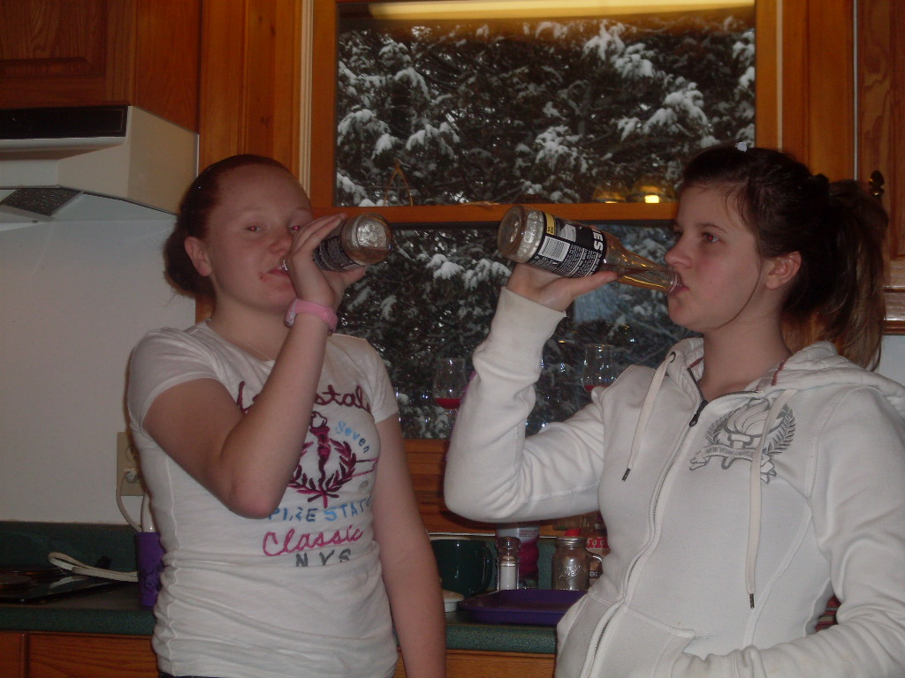
Explaining
For our product testing we decided to test if the magic bullet could prepare any meal in ten seconds or less. So we went to the official magic bullet website and we got some recipes to test. Then we went through the commercial and we picked out any hidden messages we could find and we brought you this presentation so enjoy ☺

Slide 3
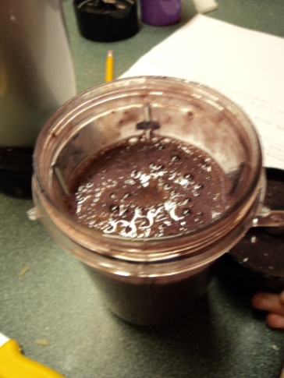
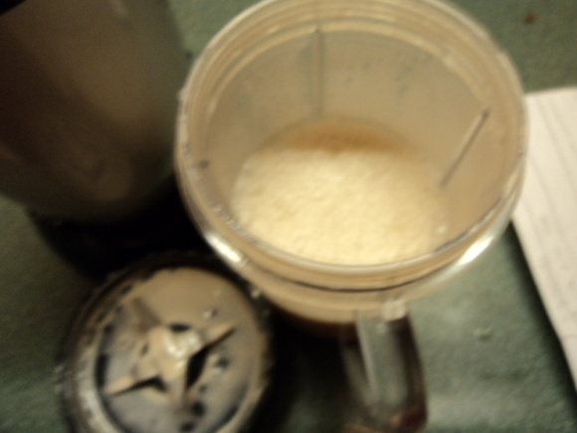
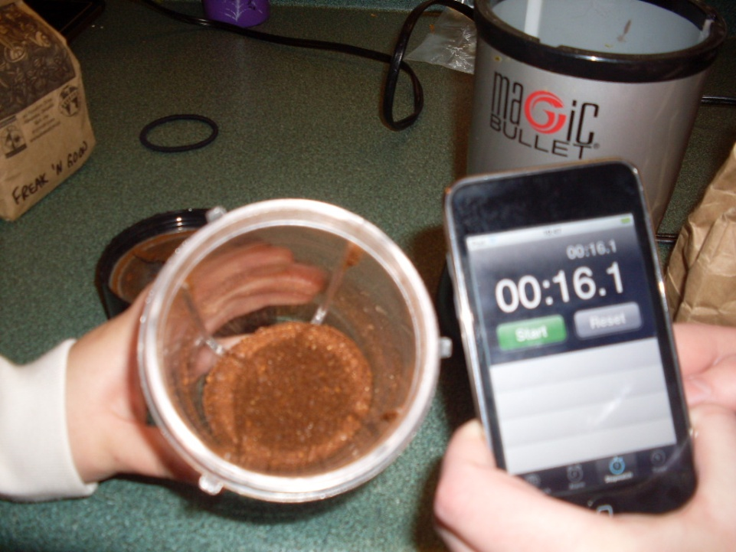
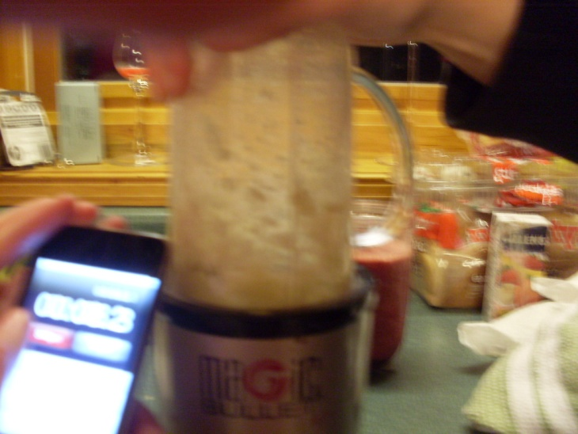

Recipes.
Chocolate mousse, Blackberry smoothie, Sorbet, chopped onions and ground coffee beans.
mousse
coffee
smoothie
onion
shorbert

Slide 4
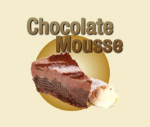
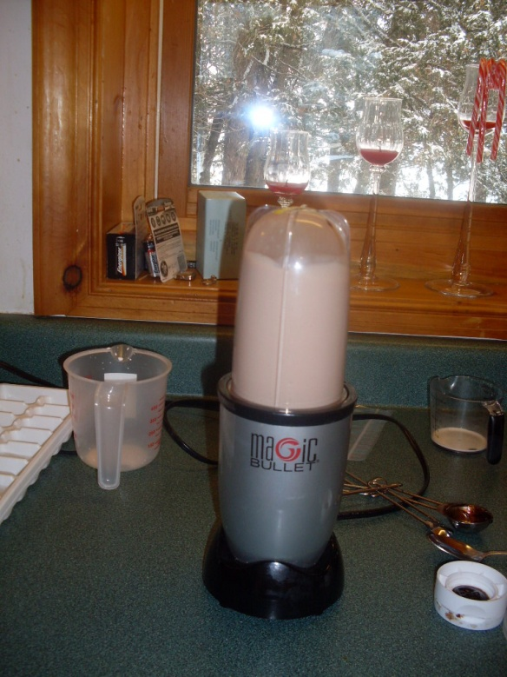
Magic bullet chocolate mousse
Magic Bullet Commercial
Our Finding
In 6 seconds this is what it looked like:
In 24 seconds (which is three times as long!) It looked like this

Slide 5
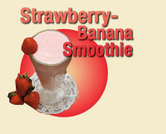
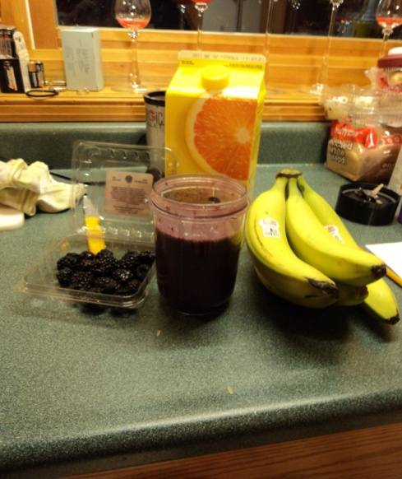
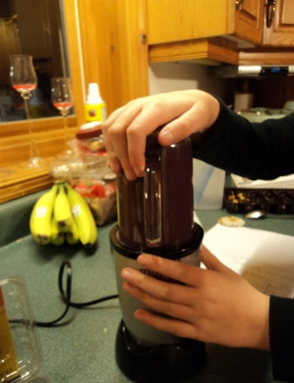
Smoothie yum
Magic Bullet Commercial
Our findings
In 8 seconds it looked like this. (they used ice, bananas (chopped) ‘strawberries and orange juice) all in less than 2 minutes!
Before even using the magic bullet we had to manually chop the bananas, uses 3 big ice cubes, and had to get all the fruit and juice. This took a total of 12.41 minutes from start to finish (including the 24 seconds it took to actually make the smoothie in the magic bullet

Slide 6
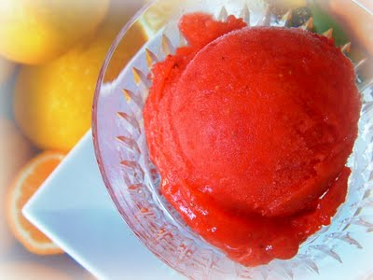
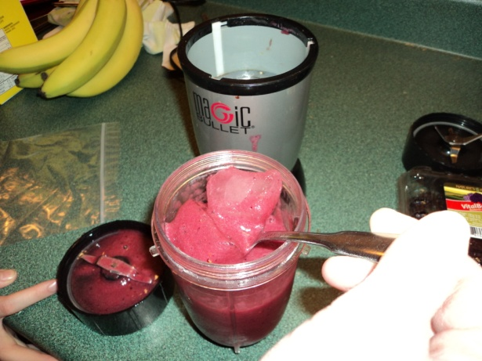
Sorbet
Magic Bullet Commercial
Our findings
In 8 seconds the commercial stated it would look like this using frozen fruit and juice
(normally orange juice)
While for the commercial it took 8 seconds it took us 40 seconds to recreate it... Almost... we had to substitute the frozen fruits with cold refrigerated fruit. And ice cubes were still whole☹ !!!!!

Slide 7
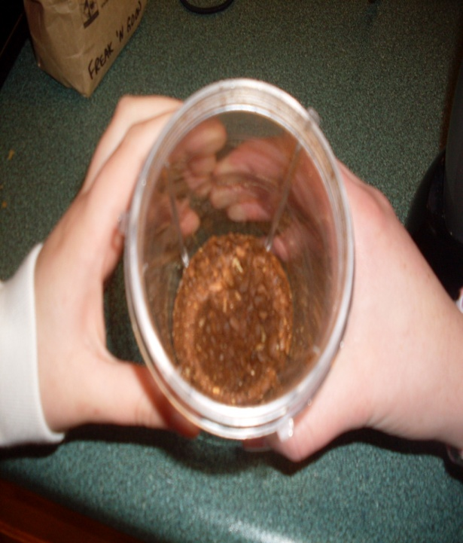
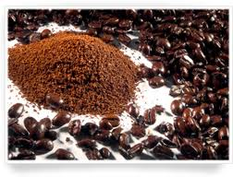
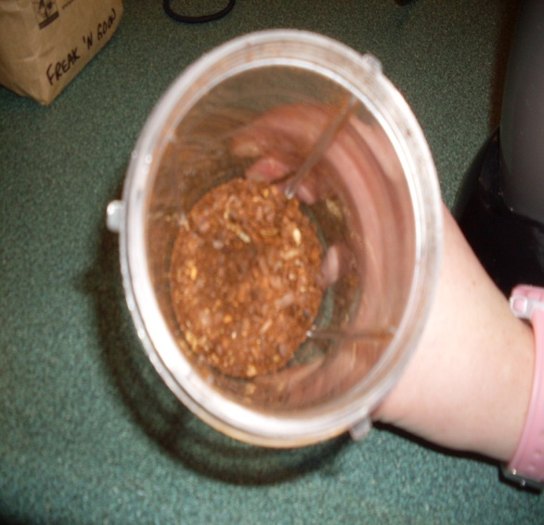
Ground Coffee
Magic Bullet Commercial
Our Findings
“Perfectly ground coffee beans in less than 4 seconds” this is what the commercial says for the magic bullet
Took about 16 seconds and we could still see whole coffee beans. This doesn't live up to its expectations

Slide 8

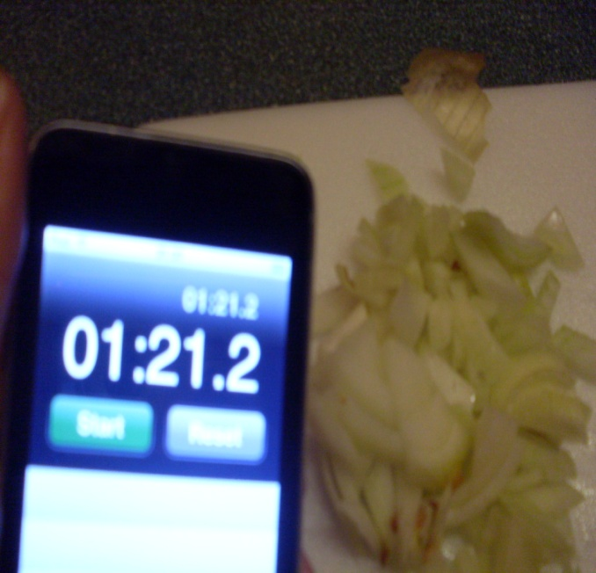

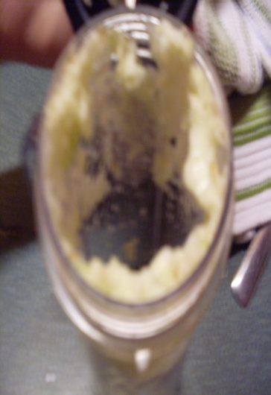
Chopped onion
Magic Bullet Commercial
Our findings
Made in 3 seconds makes the onion chopped to perfection
This didn't even chop onions we did a side by side test and it took us 1 min and 25 seconds to chop manually and the magic bullet pureed it in 13 seconds .

Slide 9
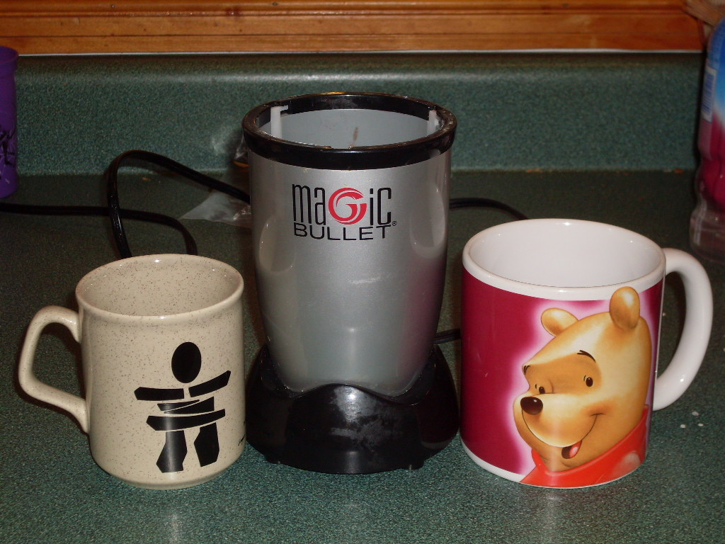
Coffee mug

Slide 10
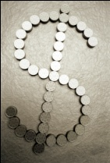
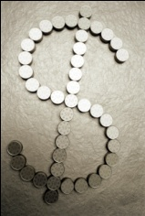

What they don't want you to know
It says “$99.99” but in the fine print it says “$139.37 plus shipping and handling.”
It also says “ the program you are watching is a paid ad for the magic bullet”, meaning that the chefs were paid to say good things about the product.
Also when we were watching the ad. We seen the chef putting things and taking them out of the fridge constantly but they never said that in the commercial nor in the recipes.
The Magic Bullet is suppose to take up no more room on your counter than an average coffee mug but even the largest mug in the cupboard didn't compare to the size.
It is said to be odourless when chopping smelly food like onions and garlic but during the onion test that was the only thing you could smell.
In the commercial when making the food the chefs already had all the ingredients sitting out pre chopped and already prepared for the magic bullet.
Last but not least the ten second rule is totally bogus, from our recipes they all took about 3 to 4 times longer then it said in commercial.

Slide 11
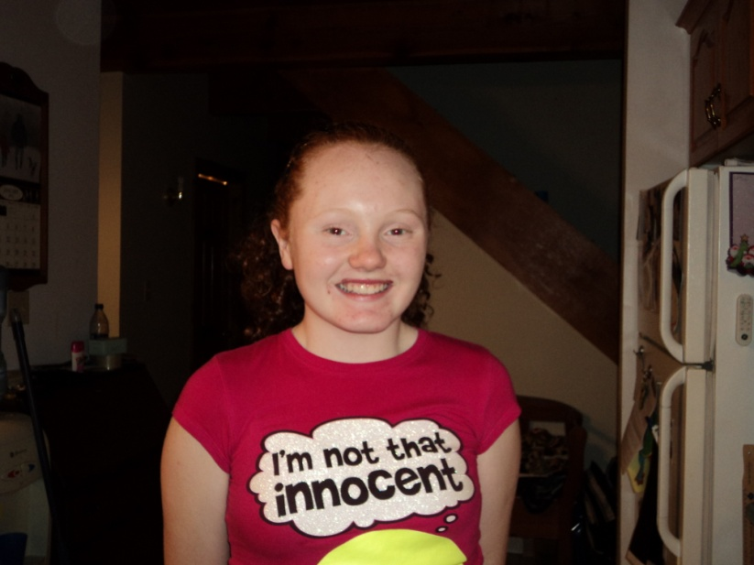
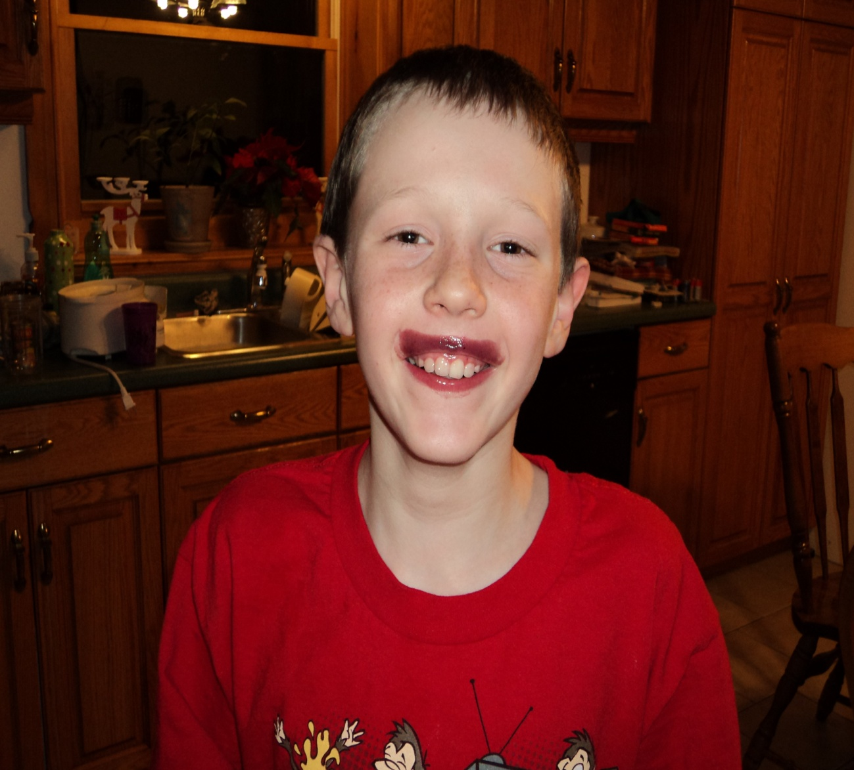
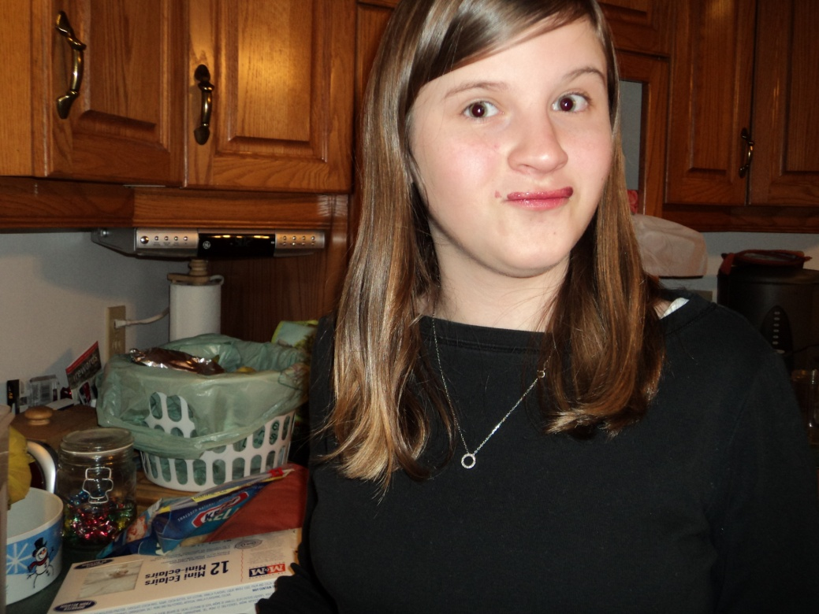
Smoothie tasting moustaches!

Slide 12
Special thanks
Thanks to Curtis Jones for being our taste tester and for Diane and Mark Jones for letting us destroy their kitchen, eating all of their fruit and drinking all of their orange juice

