Slide 1
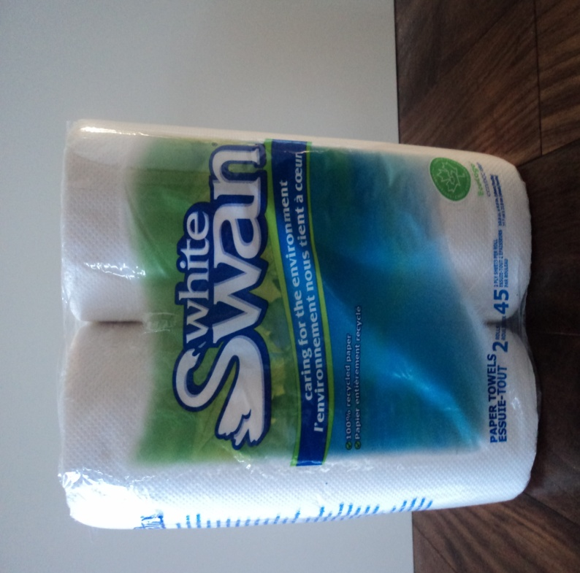
Bounty Paper Towel vs. White Swan Paper Towel
vs.
Presentation By: Rachel Martin & Olivia Elliott

Slide 2
Examining a Bounty Paper Towel Commercial and It’s Claims
http://www.youtube.com/watch?v=OVMX1F0rNlM
Bounty Paper Towels have built their reputation around the “quicker picker upper” campaign when it comes to cleaning up spills around the house.
“From sticky spills to finger paints, Bounty has the strength, absorbency, and durability to soak up the messes life can bring.”
The company claims that their “thicker” towels are more “absorbent” and more “durable” than bargain brands.
They claim that in laboratory tests that Bounty sheets were able to clean up spills “twice” as fast as bargain brands.
“Why use more when you can use less”.
They imply that the extra absorbency allows for the use of fewer towels per spill than bargain brands. This implication suggests that their towels will “save ” a busy consumer (who is trying to be “smart with the family budget”) money and time over the long run.

Slide 3
What We Intend To Do
We intend to run a series of experiments that will test the claims that the Bounty Company makes.
Times Savings -We will test whether there is a significant amount of time saved by using Bounty Paper towels to clean a spill versus a bargain brand (White Swan).
Absorbency - We will test whether Bounty is indeed more absorbent and durable than bargain brands.
Price - We will also compare the price of a roll of Bounty Paper Towels to that of White Swan in order to see if the consumer is actually saving money over the long run.

Slide 4
Introduction
We have tested the strength and durability of Bounty Paper Towels, to see if this brand of paper towels meets the expectations of the tests that the commercial claims.
We have performed multiple tests for the strength, durability, and absorbency of the Bounty paper towels, and we chose to compare Bounty to White Swan paper towels to see if the Bargain Brand is better than Bounty.
First, we will start off by re-showing the Bounty commercial so that you can see what positive things it claims about Bounty paper towels.
http://www.youtube.com/watch?v=OVMX1F0rNlM
Notes:
positive

Slide 5
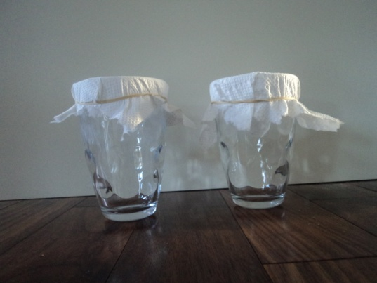
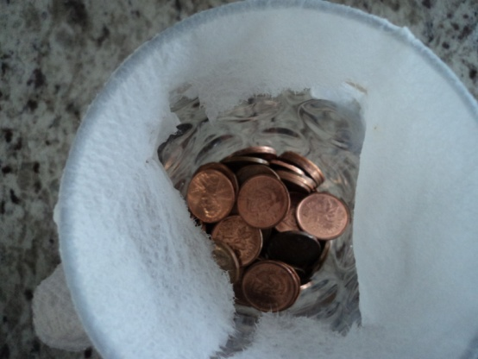
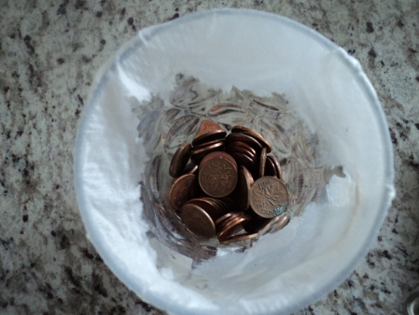
Strength & Durability
Test #1 Strength and Durability of Bounty paper towels compared to the Bounty paper towels, we used an elastic band and tied a piece of each type of paper towel to the top of a glass. We then poured 3 teaspoons of water in the middle of the paper towel. Then we placed coins (pennies) on the wet area of the paper towel and saw how many coins each type of paper towel would hold without tearing and landing in the jar.
Bounty
White Swan
Bounty paper towel held 122 pennies before the paper towel ripped and was no longer able to hold more weight.
White Swan paper towel held 103 pennies before the paper towel teared and the pennies fell through.
These tests indicate that the Bounty paper towels were slightly stronger and lasted longer than White Swan paper towels.

Slide 6
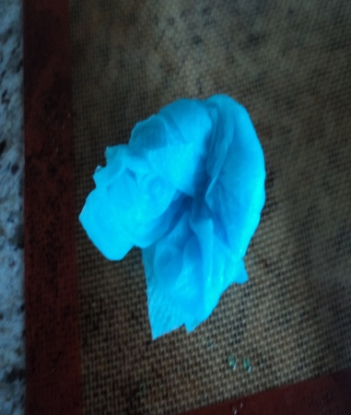
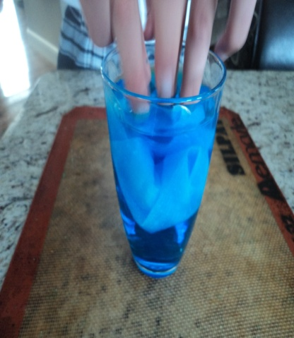
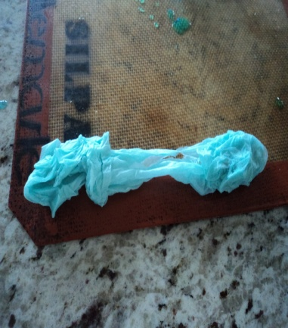
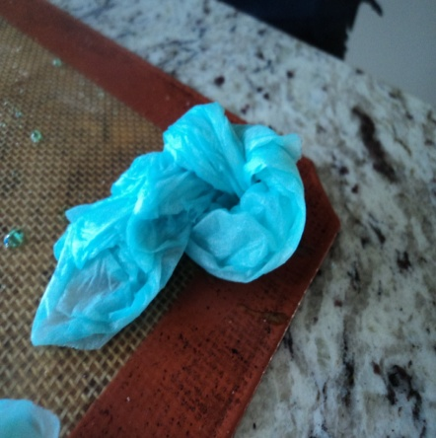
Strength & Durability
Test #2 Strength and Durability,
We fully wet both brands of paper towel and attempted to tie a knot into each piece without it tearing. We cut the paper towel to make the pieces the same size (10 cm by 8 cm), and then used blue food colouring to make the water more visible.
Bounty
White Swan
When we used the Bounty paper towel, we were able to tie the paper towel in a knot without it ripping.
On our first try with White Swan the paper towel ripped, the second try, the paper towel ripped again and we were not able to tie it into a knot.
1st Try
(No Rip)
According to this test, the Bounty sheets were more durable and stronger.
1st Try
2nd Try
(Paper Towel Still Ripped)

Slide 7
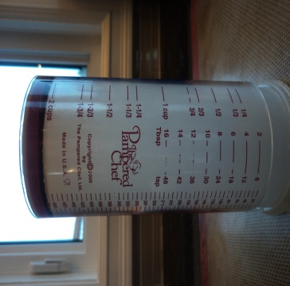
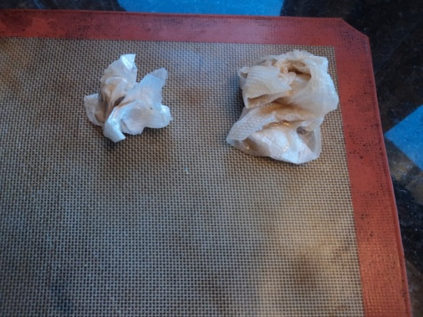
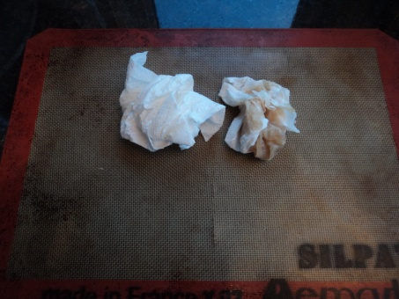
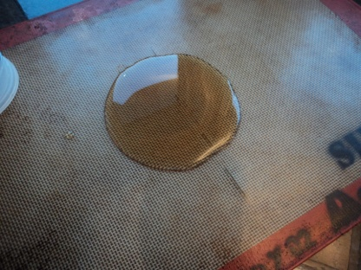
Strength & Durability
Test #3 Strength and Durability
In this test we measured 40 mL of syrup, to see if Bounty paper towels could wipe up a sticky mess from a flat surface more efficiently than White Swan paper towels. We counted how many strips of each brand of paper towel it took to wipe up each mess and then manually checked the surface for the remains.
Bounty
White Swan
When we used the Bounty paper towel, it was able to wipe up the sticky syrup, only using one piece of paper towel, and a quarter section of the second piece. The table was clean and there was no evidence of stickiness afterward..
When we used the White Swan paper towel, it used two full pieces of paper towel to wipe up the mess, and the surface was still slightly sticky.
According to our tests, Bounty paper towel is slightly more durable with sticky messes than the Bargain Brand (White Swan).

Slide 8
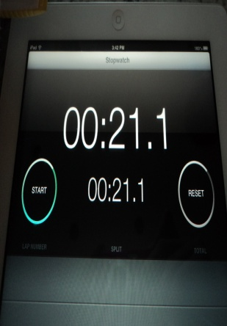
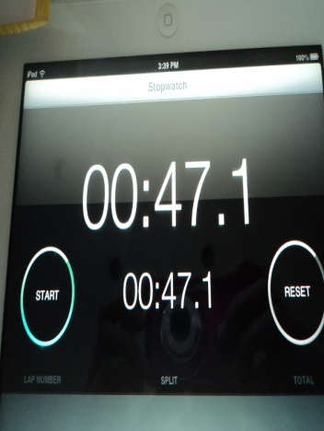
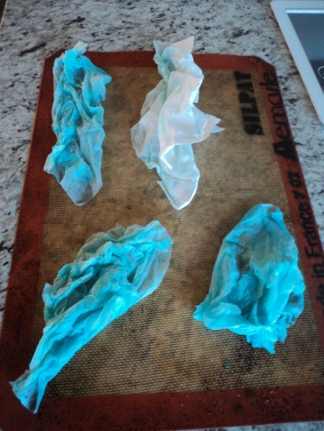
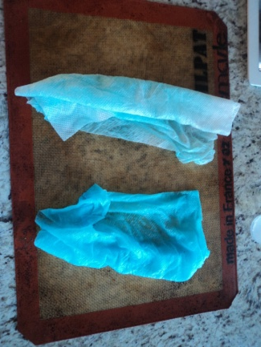
Absorbency
Test #1 Absorbency
We tested how many pieces of paper towel from each brand (Bounty and White Swan) it takes to wipe up a spill of 25 mls of water (coloured with blue dye) as well as how long it takes to wipe up the liquid. Note: This was the same test that was performed in the commercial in which (in small print) it states that it took 16 seconds.
Bounty
White Swan
Bounty paper towel took 2 pieces of paper towel in 21 seconds to wipe up the water.
It took 4 pieces of White Swan paper towel 47 seconds to wipe up the spill.
In comparison to the original commercial, it took us 1 more piece of paper towel and 5 more seconds, however like the commercial stated, Bounty absorbed twice as much as the bargain brand.

Slide 9
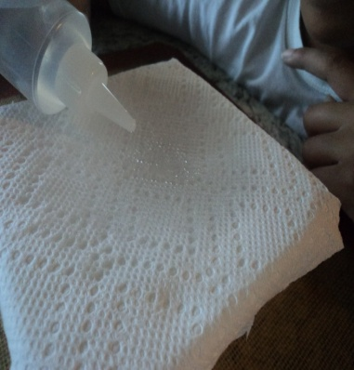
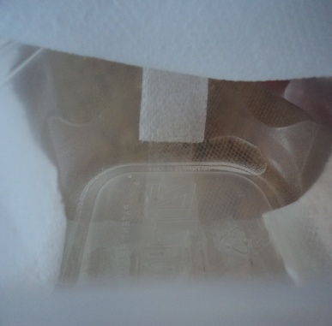
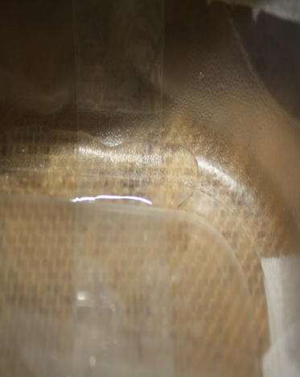
Absorbency
Test #2 Absorbency
In this test we measured the amount of liquid each paper towel would absorb before leaking through. We held a piece of paper towel over a glass, and dripped water from an eye dropper. We counted how many drops of water each container could hold, before the water started to leak through the paper towel.
Bounty
White Swan
Bounty paper towel absorbed 54 drops of water before it leaked through.
The White Swan Paper towel absorbed 21 drops of water before it started to leak through.
Bounty paper towel was 2 and a half times as absorbent as White Swan!

Slide 10
Cost Comparison
2 rolls of Bounty White Paper Towels cost $5.99. Each roll consisted of 44 sheets. This works out to $0.068 per sheet.
2 rolls of White Swan Paper Towels cost $2.99. Each roll consisted of 45 sheets. This worked out to $0.033 per sheet.
As you can see, Bounty Paper Towels cost twice as much as White Swan Paper Towels.

Slide 11
In Conclusion....
We conclude that Bounty paper towel was more of an efficient paper towel than White Swan. It costs twice as much and thus consumers should expect twice the performance. Due to it’s improved efficiency, the consumer will save time using Bounty over a bargain brand, but will ultimately save little financially.
After the testing, we conclude that the commercial itself didn’t mislead the consumer much, but it didn’t tell the complete story either. The commercial stated that Bounty paper towels, are the” Quicker picker upper” and indeed our tests proved that the company can continue to confidently make this claim.
“Why use more when you can use less?” Use Bounty!
Why use more when you can use less?
Why use White Swan when you can use me?

