Slide 1
Opening The West
The creation of Manitoba
A Provisional Government
Louis Riel & The Métis

Slide 2
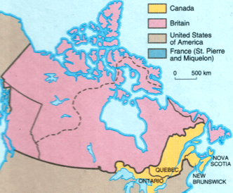
How Canada looked in 1867 after Confederation

Slide 3
The new Canadian government wished to expand their territory westward. They were interested in purchasing the land known as Rupert’s Land , which was still owned by the Hudson’s Bay Company. This was a British owned company which owned 15% of the North American acreage at this time.
The Métis were happily living their lives in Manitoba. They went about their business as they had been doing for generations beforehand. Things however were changing:
Anglophone Protestants were beginning to move from Ontario to the Red River area. These settlers were insensitive to Métis culture and were hostile to Roman Catholic traditions.
At the same time many Americans were moving Northward and they were in favour of annexation of the territory by the United States. To forestall this the British and Canadian governments were negotiating the transfer of Rupert’s Land from the HBC to Canada. It was authorized in the Rupert’s Land Act of 1868. On December 1, 1869 Canada officially purchased the territory. However there were still problems . . .

Slide 4
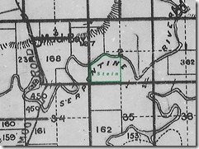
Before the Canadian government officially bought the land they sent out surveyors to mark the land into square sections as was done in Ontario.
These surveyors entered the territory and treated it as if it was not already settled (which it was by the Métis).
The Métis had heard of plans by the Canadian government to purchase their land and they set up patrols to preserve what they felt was their land by right.
On October 11, 1869 the surveyors attempted to run their lines over Métis farmer Andre Nault’s hay field. A Métis patrol lead by 24 year old Louis Riel quickly appeared to stop them. Riel spoke to them in English and declared that the territory belonged to the people of Red River and not to Canada. He told them to leave, they did.

Slide 5
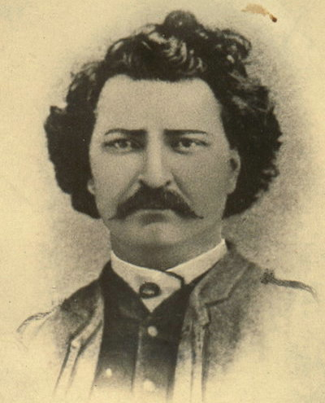
Who Was This Man Louis Riel?
Born 1844 to Louis Riel Sr. And Julie Lagimodiere. He was the eldest of eleven children. At the age of 13 in 1858, he was recommended to attend a college in Montreal for young men interested in joining the Roman Catholic priesthood.
After hearing the news of his father’s death in 1864 Riel lost interest in the priesthood and withdrew from the college in 1865. He remained in Montreal for over a year where he worked as a law office clerk . During this time he was involved in a failed romance with a young woman named Marie-Julie Guernon. Her family did not agree with her choice of a partner (due to his Métis heritage) and would not allow the union. In 1866 Riel left Canada East. He found work in Chicago and in Minnesota prior to returning to the Red River area in 1868.

Slide 6
Upon Riel’s return to Red River he noticed many tensions related to the increase of settlers from Ontario. There was also a lot of political unrest due to the negotiation of the transfer of Rupert’s Land. The Métis were fearful because they did not hold titles to their land which were set out in seigniorial lots as apposed to the English – style square lots.
The Métis were also afraid of losing their language (French) and religion ( Catholic). They feared marginalisation and discrimination in what had originally been wide open prairie with virtually no one governing them.
Riel and a party of Métis stopped the surveyors, simply by asking them to leave in their own language.
This Métis party named themselves : “The Métis National Committee”. In Métis tradition the best hunter John Bruce was named the president of the committee with Louis Riel named as secretary.
When asked about his actions to stop the surveyors, Riel declared that any attempt made by Canada to assume authority over the Red River area would be contested unless they negotiated first with the Métis.

Slide 7
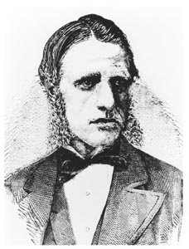
The surveyors had been sent out by the Minister of Public Works, William McDougall. After the surveyor’s run in with the Métis, McDougall was appointed as governor of the territory and he rode out to claim the land for the Canadian Government.
McDougall attempted to enter the territory by travelling through the United States but was stopped at the border between the two countries. On the same day Riel and a group of Métis stormed Fort Garry and took it over with little resistance. Riel hoped that by making this bold move he could convince the Canadian government of the Métis rights to their land and of their place in Canada. Riel believed that the Métis people had the right to negotiate the terms under which they would enter into the Canadian Confederation.
As the government was informed of the situation in the North –West Territory (as it was to be called once it joined Canada) they decided to postpone the takeover. Not knowing this McDougall held a ceremony at Fort Dufferin on December 1, 1869 and formally took over Rupert’s Land from the HBC.

Slide 8
Some Questions To Think About:
Why was the Canadian Government so interested in Rupert’s Land? What was the advantage to owning it?
Why were the Métis so opposed to having the Canadian government take over their land? How would their lives be affected by such a takeover?
How were Métis leaders chosen? How does this reflect the election of Sir John A. as Canada’s Prime Minister?
Who is Louis Riel and why was he so passionate about Métis rights?
What was William McDougall’s big mistake? How do you think it will effect Riel and the Métis struggle for acknowledgement?

Slide 9
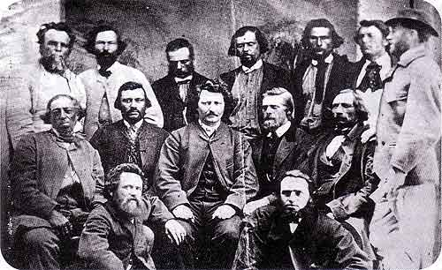
A Provisional Government:
Definition of a Provisional Government: providing or serving for the time being ; existing until permanently or properly replaced.

Slide 10
After the Métis overtook Fort Garry they created a provisional government. They were making yet another example to Canada that they were willing to negotiate terms, but that they would not back down from what they believed to be their rights as future citizens of Canada.
They created the Métis Bill of Rights which outlined three key points:
Respect the customs and rights of the people of the North-West including their Catholic faith.
Recognize both French and English as official languages
Guarantee that the people of the North-West could elect their own legislature and be fairly represented in the Canadian House of Commons. (Red River to become a province of Canada not just a large territory)
Canada responded by sending three delegates from Ottawa to meet with the provisional government in early January of 1870. However this meeting proved fruitless. Later on January 7th Riel agreed to send representatives to Ottawa to engage in direct negotiations based on the terms outlined in the Métis Bill of Rights.
Meanwhile:

Slide 11
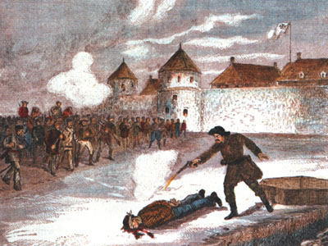
Execution of Thomas Scott

Slide 12
Some of the English settlers along the Red River did not agree with Riel and they resented his actions against their government. They joined together to create “The Canadian Party”. They plotted against the provisional government and attempted to derail the Métis negotiations.
On February 17th, 1870 a group of 48 Canadian Party members attempted to re-take Fort Garry were arrested and put in jail. One man (Thomas Scott) had already escaped from his captors once. He was repeatedly warned for his abuse and contempt towards his Métis captors and against Riel especially. He encouraged his fellow inmates to rebel and even threatened Riel’s life. Finally after a quarrel with his guards he was court marshalled for insubordination. He was found guilty of defying authority and was sentenced to death. Riel justified his actions by arguing that he needed to make an example to the Canadians that the Métis were to be taken seriously.
Thomas Scott was executed by firing squad on March 4th.

Slide 13
Scott’s death was interpreted by many English Canadians as cold blooded murder. They called for revenge. The French Canadians on the other hand felt sympathy with the Métis. This would cause a divide which can still be seen today.
Due to the English outcry for revenge the Canadian government decided to send troops to take control of the situation in Red River. They were also in the process of negotiating the terms in which the area would join the existing provinces. They created the Manitoba Act .
Manitoba became the fifth province of Canada officially on July 15th 1870. It was smaller than those living in Red River had hoped it would be and they did not have control over the use of their resources (water, timber, etc) but the Métis did receive their rights over their land and their language and also for the right to have their children educated in Catholic schools.
Riel got to choose the name “ Manitoba” for his province. This word is based on a Cree and Assiniboine word translated as meaning “the spirit that speaks”.
Remember those troops from Ottawa? They arrived in August of that year and caused Riel and other Métis leaders to flee to the United States. The Canadian government also officially banished Riel from the country for five years.

Slide 14
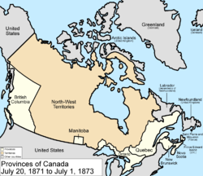
Map of Canada with Manitoba

Slide 15
Some Questions To Think About:
1) Define a provisional government. Why did Louis Riel and the Métis resort to declaring a provisional government?
2) What were the three key terms under the Métis Bill of Rights?
3) Who was Thomas Scott? What were the reasons for his execution? Do you agree with this decision?
4) Using your text book set up a chart to compare and contrast the Métis Bill of Rights with the given terms of the Manitoba Act (page 139, box 7-2). Did the Métis get all of what they asked for?

Slide 16
THE END
Or is it?
DUN DUN DUHHHHHHHHH

